Slide 1

Bank Analytics Project Tools: SQL | Excel | Power BI | Tableau
Group 2
Date: 30/08/2025

Slide 2

MEET THE TEAM
Pooja Nesarikar
Thammineni Naveen Kumar
Rahul Tiwari
Sujit Puhan
Heena Goyal
Jothiroopan Velayuthan
Kiran Kumar Palled

Slide 3
Agenda
Data & Tools Overview
Key Performance Indicators (KPIs)
Observations & Insights (per KPI)
Recommendations for 2025
Challenges & How We Overcame Them
Conclusion

Slide 4

Data & Tools Overview
Dataset
Loan customer records from Finance_1 & Finance_2
Fields: loan amount, grade, sub-grade, verification status, DTI, revolving balance, payments, state, issue & payment dates
~39,717 unique customers
Tools Used
SQL → Data extraction, joins, cleaning, KPI preparation
Excel → Data validation, pivot tables, quick checks
Power BI → Interactive dashboards, KPI cards, slicers
Tableau → Advanced visualizations & storytelling dashboards
Benefits

Slide 5
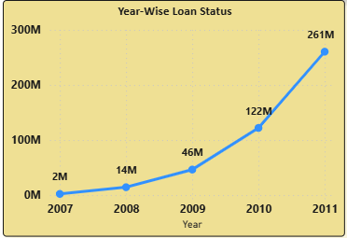
KPI-1
Observation – Year-wise Loan Analysis
Loan amounts grew consistently (2007 → 2011)
Peak in 2011: ₹261M
No decline in dataset
Inference
Strong market demand & growth
2011 as benchmark year
Recommendation
Expand in top states & purposes
Push verified loans
Replicate 2011 strategies in 2025

Slide 6
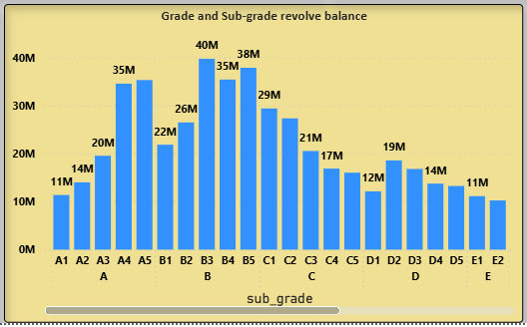
KPI-2
Observation – Grade & Sub-Grade vs Revolving Balance
Higher revolving balances concentrated in mid-tier grades (B, C, D)
Premium grades (A) show lower balances → safer borrowers
Sub-grades show clear risk segmentation
Inference
Bank portfolio leans towards moderate-risk borrowers
Risk of defaults higher in lower grades (E, F, G)
Recommendation
Maintain exposure to A/B grade borrowers
Strengthen credit checks for C/D/E borrowers
Consider adjusting interest rates by grade/sub-grade

Slide 7
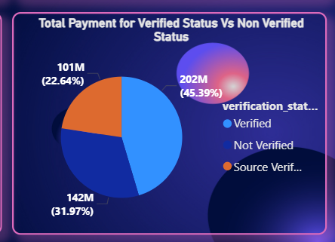
KPI-3
Observation
Verified borrowers contribute higher total payments
Non-verified borrowers contribute significantly less
Strong correlation between verification and repayment success
Inference
Loan verification improves repayment reliability
Non-verified loans carry higher default risk
Recommendation
Move toward 100% verification policy for new loans
Automate verification to reduce processing time
Prioritize lending to verified borrowers for portfolio stability

Slide 8
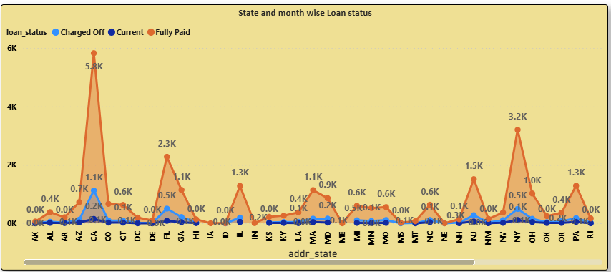
KPI-4
Observation
Loan distribution varies significantly by state
Top states contribute the highest loan amounts
Seasonality trend: December and mid-year months show higher loan issuance
Inference
Loans are concentrated in a few high-demand states
Seasonal peaks suggest customer behavior patterns (festive season, year-end financial planning)
Recommendation
Focus marketing campaigns in high-performing states
Design seasonal loan offers (e.g., year-end personal loan promotions)
Explore underperforming states for growth opportunities

Slide 9
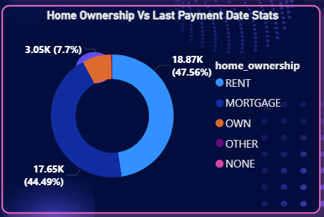
KPI-5
Observation
Majority of loans come from Mortgage holders
Renters form the second largest group
Owners (no mortgage) contribute the least
Repayments are more consistent among Mortgage borrowers
Inference
Mortgage customers are more stable and reliable borrowers
Renters show higher variability in repayment patterns
Home ownership strongly correlates with repayment discipline
Recommendation
Prioritize lending to Mortgage customers (lower risk, steady repayments)
Tailor products for renters with stricter credit checks
Explore special loan products for owners (no mortgage) to increase share

Slide 10
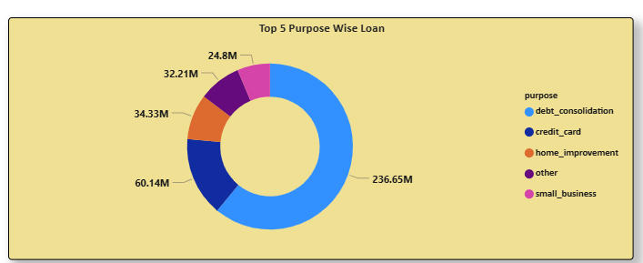
KPI-6
Observation
Top purposes: Debt Consolidation, Credit Card, Home Improvement, Other, Small Business
Debt Consolidation has the highest loan share
Loan distribution shows focus on consumer debt repayment
Inference
Borrowers primarily use loans to manage existing debt
Smaller share for investment-related purposes (small business, home improvement)
Recommendation
Diversify loan offerings (education, auto loans, business loans)
Encourage growth in productive categories (small business, home improvement)
Continue supporting debt consolidation, but balance portfolio to reduce risk

Slide 11

Group 2
Challenges & How We Overcame Them
Challenges Faced
Data quality issues (nulls, commas, unwanted spaces) → heavy to upload in SQL/Tableau
Large dataset → performance issues in SQL/Tableau
Joining Finance_1 & Finance_2 correctly (ID vs Member ID confusion in Tableau)
Handling tool differences (SQL vs Power BI vs Tableau outputs)
How We Overcame Them
Cleaned Finance_1 & Finance_2 (removed commas, null columns, spaces) → reduced file size → uploaded to SQL
Used SQL UNION to merge data correctly
Resolved Tableau joins → used Member ID instead of ID
Validated results with Excel pivots before visualization
Team collaboration to align outputs across all tool

Slide 12

Conclusion
Key Takeaways
Final Recommendations for 2025
Replicate 2011 growth strategies for loan expansion
Push 100% verification for all loans
Focus on Mortgage borrowers & A/B grades
Diversify purposes (business, education, home improvement)
Leverage state & seasonal patterns for targeted campaigns
Use dashboards (SQL + Power BI + Tableau) for continuous monitoring
Loan amounts grew steadily (2007 → 2011), peak in 2011: ₹261M
Verified loans = higher repayments, safer portfolio
Mortgage customers = most reliable borrower segment
Top loan purpose = Debt Consolidation → portfolio heavily tilted
Seasonal & state-wise peaks → Dec + states like CA, NY, TX

Slide 13
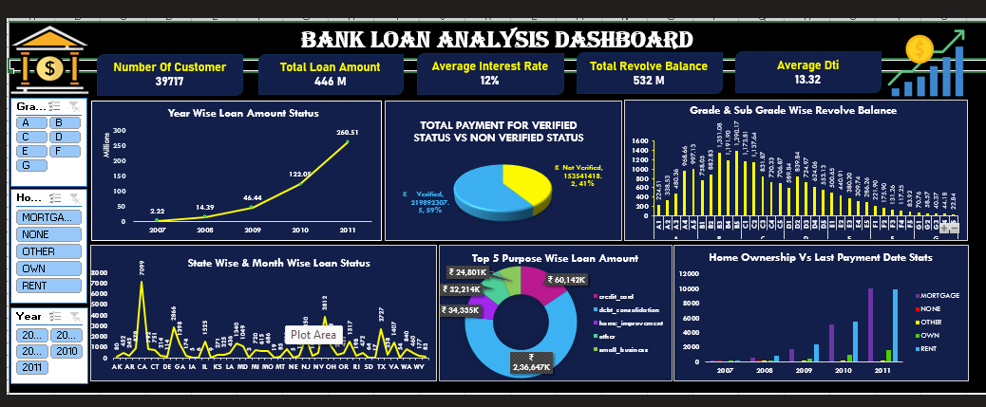
Excel-Dashboard

Slide 14
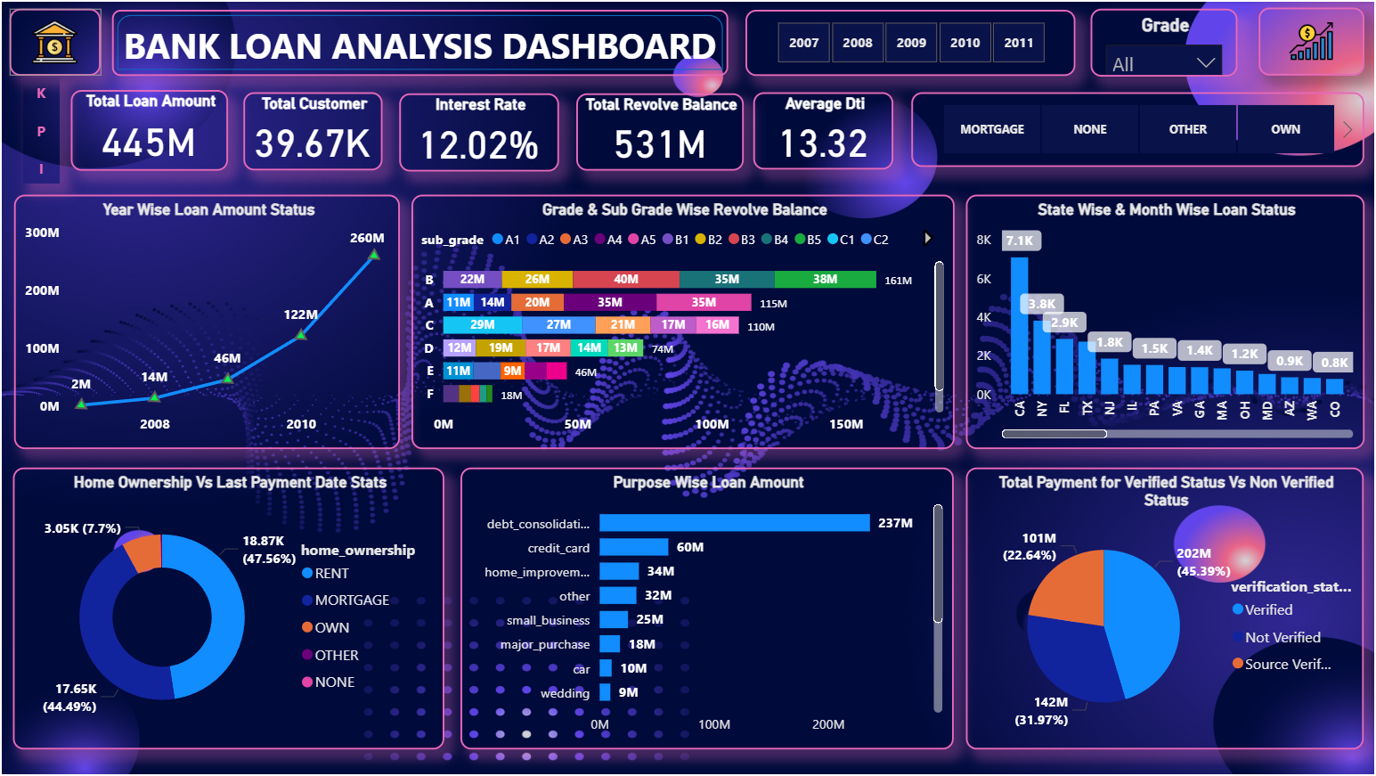
PowerBI-Dashboard

Slide 15
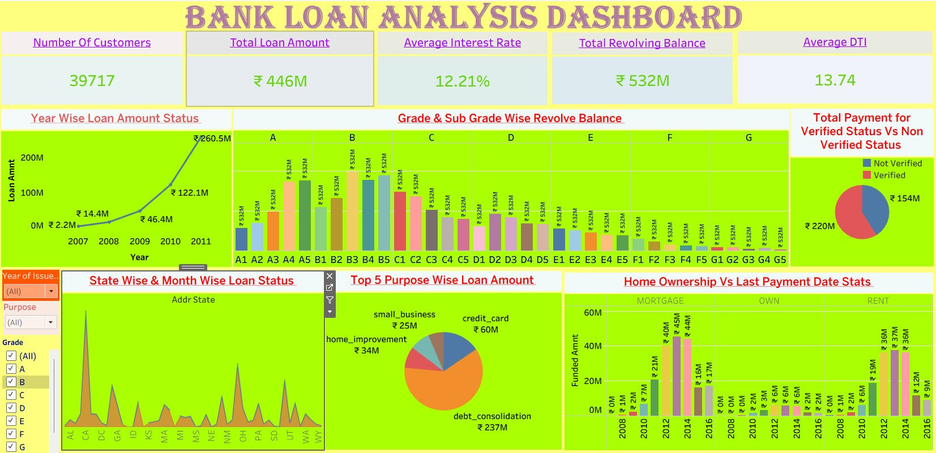
Tabelu-Dashboard

Slide 16
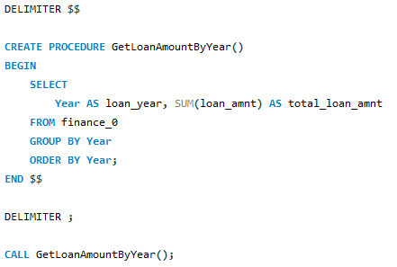
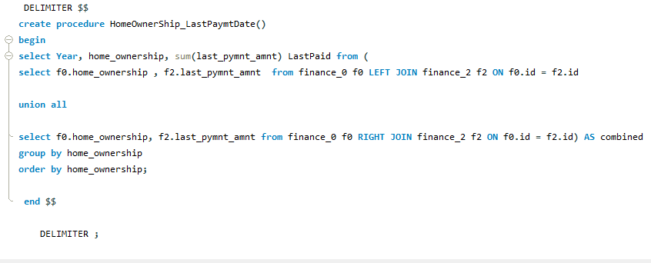
SQL-QUERIES

Slide 17
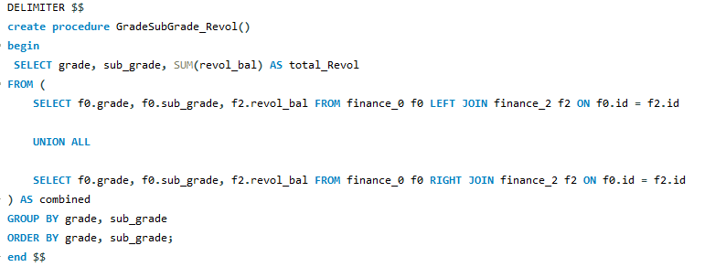
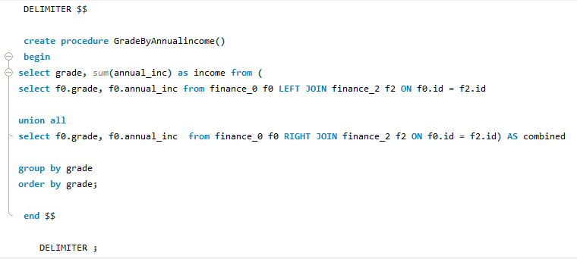
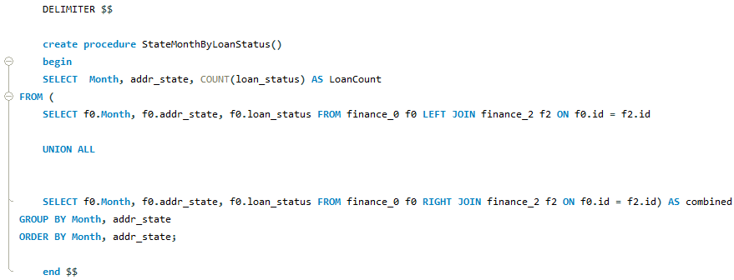

Slide 18
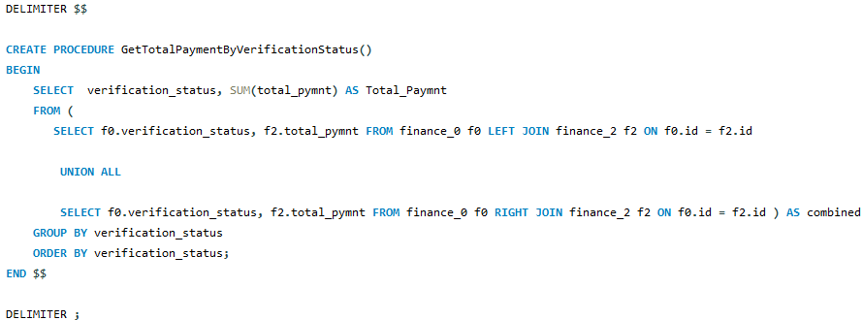
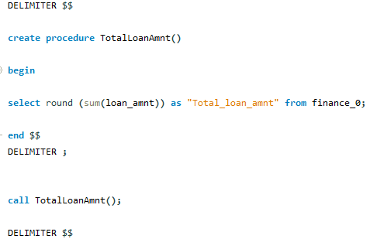
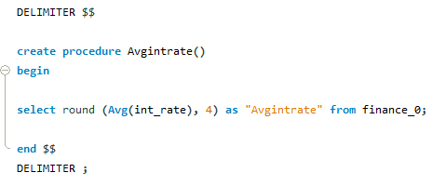

Slide 19

THANK YOU! To all team members for their valuable contributions
Key Learnings
Importance of data cleaning before analysis
SQL helps manage and optimize large datasets
Excel useful for validation & pivot analysis
Power BI → quick KPI dashboards, slicers, interactivity
Tableau → advanced visuals & storytelling
Team collaboration = solving tool & data challenges

